Slide 1
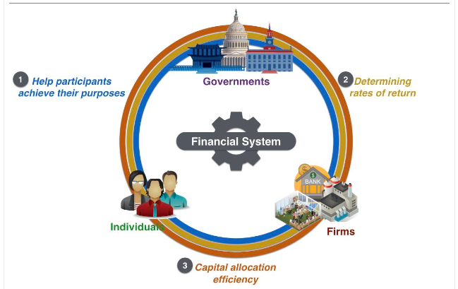
Chapter 11: G0201
Financial System
Saving and Investment

Slide 2
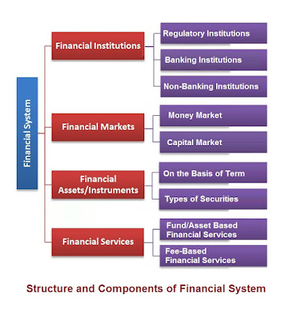
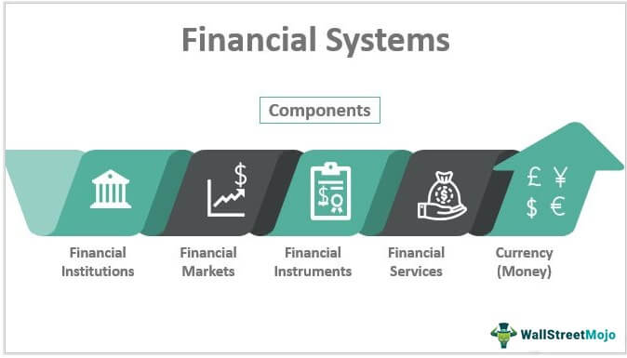

Slide 3
Financial Institutions
Financial system
Group of institutions in the economy
That help match one person’s saving with another person’s investment
Moves the economy’s scarce resources from savers to borrowers
Financial institutions
Financial markets - Savers can directly provide funds to borrowers, The bond market & stock market
Financial intermediaries - Savers can indirectly provide funds to borrowers, Banks & Mutual funds

Slide 4
Financial Markets
Financial markets
Savers can directly provide funds to borrowers
The bond market – e.g when Intel (COMPUTER CHIP CO) wants to borrow to finance its new factory, they borrow directly by issuing a BOND (cert. of indebtness) IOU - time repay (maturity date) ROI paid periodically – sell bond known as Debt Finance (increase)
The stock market – another way for Intel to raise fund by selling STOCK (ownership in a firm), claim Profit later – sell of Stock known as Equity Finance (increase)

Slide 5
Financial Markets
The bond market
Bond: certificate of indebtedness
Date of maturity, when the loan will be repaid
Rate of interest, paid periodically until the date of maturity
Principal, amount borrowed
Borrowing from the public
Used by large corporations, the federal government, or state and local governments
The bond market
Term: length of time until maturity
A few months, 30 years, perpetuity
Long-term bonds are riskier than short-term bonds
Long-term bonds usually pay higher interest rates

Slide 6
Financial Markets
The bond market
Credit risk: probability of default
Probability that the borrower will fail to pay some of the interest or principal
Higher interest rates for higher probability of default
U.S. government bonds tend to pay low interest rates
Junk bonds, very high interest rates
Issued by financially shaky corporations

Slide 7
Financial Markets
The bond market
Tax treatment
Interest on most bonds is taxable income, the bond owner Must Pay a portion of the interest earned in term of Income Tax
Municipal bonds
Issued by state and local governments
Owners are not required to pay federal income tax on the interest income
Lower interest rate
Perpetuity ( British Gov issued a bond that never matures)

Slide 8
Financial Markets
The stock market
Stock: claim to partial ownership in a firm
A claim to the profits that a firm makes
Organized stock exchanges
Stock prices: demand and supply
Equity finance
Sale of stock to raise money
Stock index
Average of a group of stock prices

Slide 9
Financial Intermediaries
Financial intermediaries
Savers can indirectly provide funds to borrowers
Banks – take deposits, makes loan
Mutual funds - sells shares to the public, proceeds to buy a portfolio of stocks and bonds

Slide 10
Financial Intermediaries
Banks
Take in deposits from savers
Banks pay interest
Make loans to borrowers
Banks charge interest
Facilitate purchasing of goods and services
Checks: medium of exchange

Slide 11

Financial Intermediaries
Mutual funds
Institution that sells shares to the public
Uses the proceeds to buy a portfolio of stocks and bonds
Advantages
Diversification; professional money managers

Slide 12
National Income Accounts
Rules of national income accounting
Important identities
Identity
An equation that must be true because of the way the variables in the equation are defined
Clarify how different variables are related to one another

Slide 13
Accounting Identities
Gross domestic product (GDP)
Total income
Total expenditure
Y = C + I + G + NX
Y = gross domestic product, GDP
C = consumption
I = investment
G = government purchases
NX = net exports

Slide 14
Accounting Identities
Closed economy
Doesn’t interact with other economies
NX = 0
Open economy
Interact with other economies
NX ≠ 0

Slide 15
Accounting Identities
Assume closed economy: NX = 0
Y = C + I + G
National saving (saving), S
Total income in the economy that remains after paying for consumption and government purchases
Y – C – G = I *****
S = Y – C – G
S = I

Slide 16
Accounting Identities
T = taxes minus transfer payments
S = Y – C – G
S = (Y – T – C) + (T – G)
Private saving, Y – T – C
Income that households have left after paying for taxes and consumption
Public saving, T – G
Tax revenue that the government has left after paying for its spending

Slide 17
Accounting Identities
Budget surplus: T – G > 0
Excess of tax revenue over government spending
Budget deficit: T – G < 0
Shortfall of tax revenue from government spending

Slide 18
Saving and Investing
Accounting identity: S = I
Saving = Investment
For the economy as a whole
One person’s savings can finance another person’s investment

Slide 19
The Market for Loanable Funds
Market for loanable funds
Market
Those who want to save supply funds
Those who want to borrow to invest demand funds
One interest rate
Return to saving
Cost of borrowing
Assumption
Single financial market

Slide 20
The Market for Loanable Funds
Supply and demand of loanable funds
Source of the supply of loanable funds
Saving
Source of the demand for loanable funds
Investment
Price of a loan = real interest rate
Borrowers pay for a loan
Lenders receive on their saving

Slide 21
The Market for Loanable Funds
Supply and demand of loanable funds
As interest rate rises
Quantity demanded declines
Quantity supplied increases
Demand curve
Slopes downward
Supply curve
Slopes upward

Slide 22
Figure 1
The Market for Loanable Funds
Interest
Rate
Supply
5%
Demand
0
$1,200
Loanable Funds
(in billions of dollars)
The interest rate in the economy adjusts to balance the supply and demand for loanable funds. The supply of loanable funds comes from national saving, including both private saving and public saving. The demand for loanable funds comes from firms and households that want to borrow for purposes of investment. Here the equilibrium interest rate is 5 percent, and $1,200 billion of loanable funds are supplied and demanded.

Slide 23
The Market for Loanable Funds
Government policies
Can affect the economy’s saving and investment
Saving incentives
Investment incentives
Government budget deficits and surpluses

Slide 24
Policy 1: Saving Incentives
Shelter some saving from taxation
Affect supply of loanable funds
Increase in supply
Supply curve shifts right
New equilibrium
Lower interest rate
Higher quantity of loanable funds
Greater investment

Slide 25
Figure 2
Saving Incentives Increase the Supply of Loanable Funds
Interest
Rate
Supply, S₁
S₂
5%
1. Tax incentives for saving increase the supply of loanable funds . . .
4%
2. . . . which reduces the equilibrium interest rate . . .
Demand
0
$1,200
$1,600
Loanable Funds
(in billions of dollars)
3. . . . and raises the equilibrium quantity of loanable funds.
A change in the tax laws to encourage Americans to save more would shift the supply of loanable funds to the right from S₁ to S₂. As a result, the equilibrium interest rate would fall, and the lower interest rate would stimulate investment. Here the equilibrium interest rate falls from 5 percent to 4 percent, and the equilibrium quantity of loanable funds saved and invested rises from $1,200 billion to $1,600 billion.

Slide 26
Policy 2: Investment Incentives
Investment tax credit
Affect demand for loanable funds
Increase in demand
Demand curve shifts right
New equilibrium
Higher interest rate
Higher quantity of loanable funds
Greater saving

Slide 27
Figure 3
Investment Incentives Increase the Demand for Loanable Funds
Interest
Rate
Supply
1. An investment tax credit increases the demand for loanable funds . . .
6%
5%
2. . . . which
raises the
equilibrium
interest rate . . .
D₂
Demand, D₁
0
$1,200
$1,400
Loanable Funds
(in billions of dollars)
3. . . . and raises the equilibrium quantity of loanable funds.
If the passage of an investment tax credit encouraged firms to invest more, the demand for loanable funds would increase. As a result, the equilibrium interest rate would rise, and the higher interest rate would stimulate saving. Here, when the demand curve shifts from D₁ to D₂, the equilibrium interest rate rises from 5 percent to 6 percent, and the equilibrium quantity of loanable funds saved and invested rises from $1,200 billion to $1,400 billion.

Slide 28
Policy 3: Budget Deficit/Surplus
Government - starts with balanced budget
Then starts running a budget deficit
Change in supply of loanable funds
Decrease in supply
Supply curve shifts left
New equilibrium
Higher interest rate
Smaller quantity of loanable funds

Slide 29
Figure 4
The Effect of a Government Budget Deficit
Interest
Rate
S₂
Supply, S₁
6%
1. A budget deficit decreases the supply of loanable funds . . .
5%
2. . . . which
raises the
equilibrium
interest rate . . .
Demand
0
$800
$1,200
Loanable Funds
(in billions of dollars)
3. . . . and reduces the equilibrium quantity of loanable funds.
When the government spends more than it receives in tax revenue, the resulting budget deficit lowers national saving. The supply of loanable funds decreases, and the equilibrium interest rate rises. Thus, when the government borrows to finance its budget deficit, it crowds out households and firms that otherwise would borrow to finance investment. Here, when the supply shifts from S₁ to S₂, the equilibrium interest rate rises from 5 to 6 percent, and the equilibrium quantity of loanable funds saved and invested falls from $1,200 billion to $800 billion.

Slide 30
Policy 3: Budget Deficit/Surplus
Crowding out
Decrease in investment
Results from government borrowing
Government - budget deficit
Interest rate rises
Investment falls

Slide 31
Policy 3: Budget Deficit/Surplus
Government – budget surplus
Increase supply of loanable funds
Reduce interest rate
Stimulates investment

Slide 32
The history of U.S. government debt
Debt of U.S. federal government
As a percentage of U.S. GDP
Fluctuated
0% of GDP in 1836
107% of GDP in 1945
Declining debt-to-GDP ratio
Government indebtedness is shrinking relative to its ability to raise tax revenue
Government - living within its means

Slide 33
The history of U.S. government debt
Rising debt-to-GDP
Government indebtedness is increasing relative to its ability to raise tax revenue
Fiscal policy cannot be sustained forever at current levels
War – primary cause of fluctuations in government debt:
Debt financing of war – appropriate policy
Tax rates – smooth over time
Shifts part of the cost to future generations

Slide 34
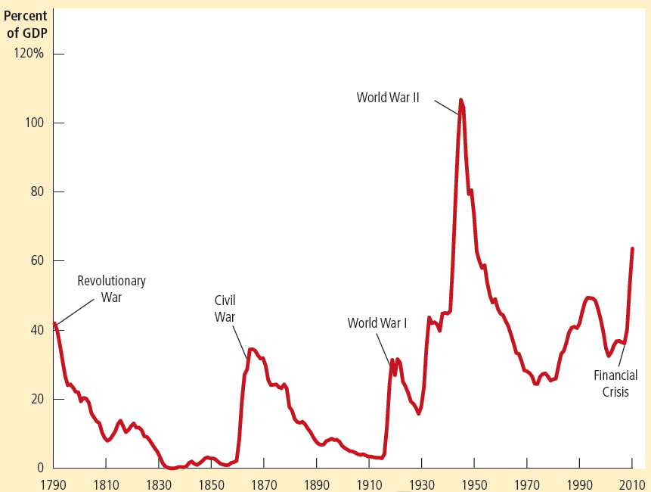

Figure 5
The U.S. Government Debt
The debt of the U.S. federal government, expressed here as a percentage of GDP, has varied throughout history. Wartime spending is typically associated with substantial increases in government debt.

Slide 35
The history of U.S. government debt
President Ronald Reagan, 1981
Large increase in government debt – not explained by war
Committed to smaller government and lower taxes
Cutting government spending - more difficult politically than cutting taxes
Period of large budget deficits
Government debt: 26% of GDP in 1980 to 50% of GDP in 1993

Slide 36
The history of U.S. government debt
President Bill Clinton, 1993
Major goal - deficit reduction
And Republicans took control of Congress in 1995: deficit reduction
Substantially reduced the size of the government budget deficit
Booming economy in the late 1990s brought in even more tax revenue
Eventually: surplus (federal budget)
By the late 1990s: debt-to-GDP ratio – declining for several years

Slide 37
The history of U.S. government debt
President George W. Bush
Debt-to-GDP ratio started rising again
Budget deficit
Several major tax cuts
2001 recession - decreased tax revenue and increased government spending
Increased government spending on homeland security
Following the September 11, 2001 attacks
Subsequent wars in Iraq and Afghanistan

Slide 38
The history of U.S. government debt
2008, financial crisis and deep recession
Dramatic increase in the debt-to-GDP ratio
Increased budget deficit
Several policy measures passed by the Bush and Obama administrations
Aimed at combating the recession
Reduced tax revenue
Increased government spending

Slide 39
The history of U.S. government debt
From 2009 to 2012
The federal government’s budget deficit averaged about 9% of GDP
Levels not seen since World War II
The borrowing to finance these deficits
Led to the substantial increase in the debt-to-GDP ratio

